Slide 1

Growth and Development of The Infant and Toddler
Infancy Stage
Third Stage
Dr. Moustafa Alshammari
Growth and Developments

Slide 2
Assessment of Normal Growth & Development of The Infant
A number of methods have been proposed to assist the nurse to evaluate that growth progresses in a regular and orderly sequence.
Tables, charts and grids are available to facilitate the nurse’s evaluation of physical growth.
In addition to the observation over a period of time, the periodic assessment of infants and children permits the early detection of growth deficiencies and pathologic processes, both organic and psychological.
2

Slide 3
[1]. Growth During The Intrauterine Period
The period of intrauterine life may be divided into two principle phases:
The embryonic period: this is considered to be the first 8 weeks during which the ovum is fertilized and beginning of the period of organogenesis.
The fetal period: 8th to 40th or 42nd week of gestation is distinguished by rapid growth and elaboration of function.
3

Slide 4
[2]. Growth During The Postnatal
Period. (Newborn Assessment)
1. Growth of head:
The posterior fontanel closes at 1-2 months, Triangular shape
The anterior fontanel closes at 12-18 months.
At birth: 3.5 - 4 cm. Diamond shape.
At birth, head circumference is 33-35 cm.
At the end of the first year, it is 45 cm.
At the second year, it is 48 cm.
At the third year, it is 49 cm.
At the fifth year, it is 50 cm. At the seventh year, it is 52 cm. At twelve years, it measures 53 cm.
And the adult head circumference is 55 cm.
4

Slide 5
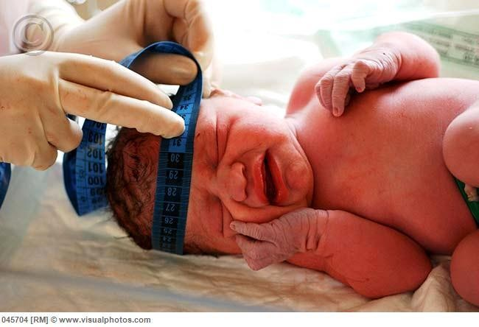
Head circumference measurement

Slide 6
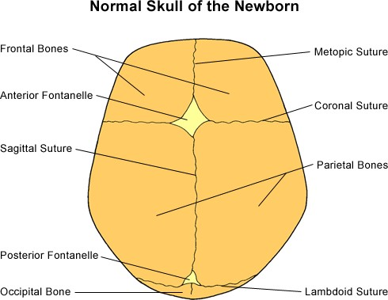
Main fontanels on the head of the newborn

Slide 7
Growth of Chest and Abdomen:
2. The chest and abdomen circumferences are equal in the first one to two years of life.
The abdomen tends to be prominent in infants and young children.
3. Chest Circumference:
At birth, head circumference is 2cm larger than chest
circumference.
Between age of 1 and 2 years both are equal.
After 2 years, the chest is larger than the head.
N.B: Chest is usually measured at nipple line, with the subject sitting in the midway between inspiration and expiration.
7

Slide 8
4. GROWTH IN LENGTH:
During the first year in life, the infant gains in length roughly 2 cm/month during the first 6 months and 1.5 cm in the second 6 months.
*At birth: 48-50 cm
A formula can be used after the first year to estimate the length of the child (Age in years x 5)+80=length in centimeters.
8

Slide 9
5. GROWTH IN WEIGHT:
There is an initial phase of loss of weight after birth
for the following factors:
1. Withdrawal of hormones from mother.
2. Loss of excessive extra cellular fluid.
3. Passage of meconium (faeces) and urine.
4. Limited food intake.
Most full terms regain their birth weight by the age of ten days. Then the weight gain averages approximately 20 – 25 gm/day.
A formula can be used after that to calculate the weight:
(Age in years X 2) + 8 = Weight in kg.
10

Slide 10
B. PHYSIOLOGICAL GROWTH:
Vital Signs:
a - Temperature: will drop immediately after birth in adjustment to delivery room temperature unless the newborn infant is kept warm immediately after birth.
Temperature rises to normal within about 8 hours. Temperature of newborn infant is usually 35.5 to
37.5 °c.
b - Pulse: 120 to 150 / min. It is usually rapid and irregular.
c - Respiration: 35 to 50 / min. It is usually irregular in depth, rate and rhythm.
d - Cry with no tears.

Slide 11
DEVELOPMENT:
Bodily functions and responses to external stimuli are carried out by reflexes.
** Reflexes: The reflexes such as: Moro-reflex, swallowing and gagging reflex. Sucking reflex, grasp reflex , tonic-neck reflexes.

Slide 12
Emotional Development:
Newborn infant expresses his emotion just through cry for hunger, pain or discomfort sensation.
Social Development:
Cry is his contact with environment; to communicate his physiological needs as hunger, throaty sounds show interest in human face.

Slide 13
Infant Normal Growth & Development
Assessment of normal growth.
Development is assessed as:
  Gross motor.
  Fine motor (sensory motor).
  Personal-social.
  Language.
  Cognitive.

Slide 14
NORMAL INFANT
Physical growth :
a - Weight gain:
Birth to 4 months - 3/4 kg / month.
5 to 8 months - 1/2 kg / month.
9 to 12 months - 1 /4 kg /month
He will double birth weight by 5-6 months and triple it by 10-12months of age.

Slide 15
Normal Infant
length
During the first year in life, the infant gains in length roughly 2.5cm cm/month during the first 6 months of age. Average height is 65 cm at 6 months and 75cm at 12 months
Increase by about 25 cm in 1st year

Slide 16
Growth of Head:
The posterior fontanel closes at 1-2 months.
The anterior fontanel closes at 12- 18 months.
Cranial sutures
  The sutures between the cranial bones do not ossify until later childhood
Head circumference increases about 1.5 cm/month during the first 6 month of age, then 1/2cm /month during the second 6 months of age.
It is 43 cm at 6 months. At the end of the first year, it is 46 cm.

Slide 17
CHEST CIRCUMFERENCE:
At the end of the first year, chest circumference and head circumference are equal .
N.B: Chest is usually measured at nipple line, for greater accuracy, take two measurements- one during inspiration and the other during expiration-and record the average .

Slide 18
Eruption of The Milk Teeth (Deciduous Teeth)
The development of human dentition is a continuous process from 5th month in utero to maturity
By 5–7 months of life, The first deciduous teeth usually erupt
Babies may differ in the timing of tooth eruption
Teething is a normal continuous process of development and does not cause fever or respiratory problems
20

Slide 19
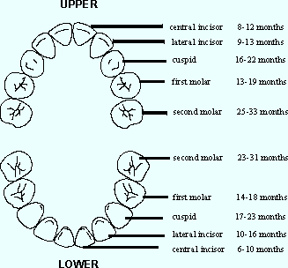
Eruption of The Milk Teeth
21

Slide 20

Gross Motor Development
1 month
Raises head momentarily when prone, hips extended When prone raises chin off couch
In a prone position, he will rest on forearm, keep head in midline, make
2 months
3 months
crawling movements with legs, arches
back, and supports head when held erect.
Sits with support. Moro reflex disappears.
4 months
22

Slide 21
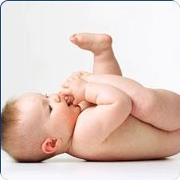

Cont. Gross Motor
Development.
26/11/2018
6 months
Puts feet in mouth in supine position. Starts crawling.
Sits without support leaning forward
7 months
8 months
Rolls over from prone to supine. Sits well with no support Creeps and pulls self upright.
9-10
months Stands unsupported.
months Walks supported. Toddles’ way and cruises around furniture.
Walks well.
Starts crawling upstairs.
23

Slide 22



MOTOR DEVELOPMENT IN INFANTS
9-11 months creeping | 12 months walks | Parachute reflex | Walks well 12 months
 | supported | 6-12 months

Slide 23
Fine Motor Development
months Follows a moving object to midline.
Responds to sounds by blinking.
months Hands often open. Grasp reflex is
fading
months Hands mostly open. Regards his hands. Can hold a rattle if placed in his hand. Follows 180° by eye.
months inspects and plays with hands. Tries to reach objects with hands. Grasps objects with both hands. Can carry objects to mouth
months Turns head to sound. Brings hands
together.
months Able to reach object by hand and get it.
Grasps feet and pull to mouth

Slide 24
7. months Can transfer a rattle from hands to hand. Reaches objects and brings them to mouth. Has ambidextrous approach
Cont. Fine Motor Development
months has beginning pincer grasp. Can feed himself with a biscuit.
months Tries picking things with fingers.
Preference for use of dominant hand
months Crude release of an object beginning.
Grasps bell by handle.
months Can use a thumb and finger to pick a cube. Grasps by thumb and finger.
months Can pick small objects “pellets "No longer puts objects in mouth. Builds a tower of 2 blocks but fails. Throw objects. Holds cup to drink.

Slide 25
Psychosocial Development of The Infant
First develops a sense of trust when fed on demand
By 2 months distinguishes mother or primary care giver
Eventually learns that not every need is met
immediately on demand

Slide 26
By 3 to 4 months: smiles in response to smile of others .shows interest in other family members
By 7 to 8 months :shows fear of strangers (strangers anxiety).
By 9 to 10 months: play simple games with adults ,e. g. ‘’bye-bye’’. play with adult games such as ‘’peek-a-boo’’ by 10 months

Slide 27

’peek-a-boo’’ by 10 months

Slide 28
He learns to trust others through the relief of basic needs, i.e., to trust those who give pleasant sensations.
Sense of trust will result also from being held, talked to, cuddled, warmed, and so... on.
If this sense of trust in others is not learned, the reverse, a sense of mistrust is. acquired
30

Slide 29
Health Promotion of The Infant
Nutrition requirements
Promoting sleep
Dental care
Accident prevention
Toy selection

Slide 30
Supplemental Nutrients That May Be Prescribed For The Infant
Vitamins C and D
Iron
  Breast-fed infants need supplements of iron, as well as vitamin D
  By 6 months of age, iron-rich foods are needed as supplements
Fluoride

Slide 31
Components of Health Promotion and Maintenance of The Infant
Routine checkups
Immunizations
Family teaching
Education about accident prevention

Slide 32
Well-baby Visits
Occur at 2 weeks, and at 2, 4, 6, 9, 10 and 12 months
The nurse collects data regarding:
  Growth and development (weight, height, head
circumference)
  Nutrition and sleep
  The caregiver–infant relationship
  Any potential problems
Immunizations are given to guard against disease
Family teaching is provided

Slide 33
Health Protection of The Infant
Immunization
BCG (Tuberculosis)
Hepatitis A and B
Polio
DPT (Diphtheria, Pertussis, and Tetanus
Measles
German measles (rubella)
Mumps
Varicella (chickenpox)
Haemophilus influenza meningitis (HIB)
Pneumococcal disease

Slide 34
Injury Prevention
Falling down
Aspiration
Poisoning
Suffocation
Burns
Motor vehicle accidents

Slide 35
Health Promotion of The Infant
a. Toy selection
Infant toys serve several purposes, including:
a) Stimulation for psychosocial development
b) Diversion for relieving boredom, pain, and discomfort
c) A means of communicating and expressing feelings
d) Aid in the development of sensor motor skills

Slide 36
Dental Health
1. An infant's primary (deciduous) teeth erupt at about age 6 months. Assessment guide: age of child in months minus 6 months equals' number of primary teeth.
2. Clean an infant's teeth with a damp cloth; brushing is too harsh for the infant's tender gums.

Slide 37
3. Assess the need for a fluoride supplement; consult with the physician.
4. Despite a widespread belief to the contrary, fever, vomiting, and diarrhea usually are not associated with teething but rather indicate illness.

Slide 38
Thank you
رمز الصف
cs5jm5o

